Slide 1
IPCC Fifth Assessment Report
Synthesis Report
2nd November 2014
Copenhagen

Slide 2
Key Messages
  Human influence on the climate system is clear
  The more we disrupt our climate, the more we risk severe, pervasive and irreversible impacts
  We have the means to limit climate change and build a more prosperous, sustainable future
AR5 WGI SPM, AR5 WGII SPM, AR5 WGIII SPM

Slide 3
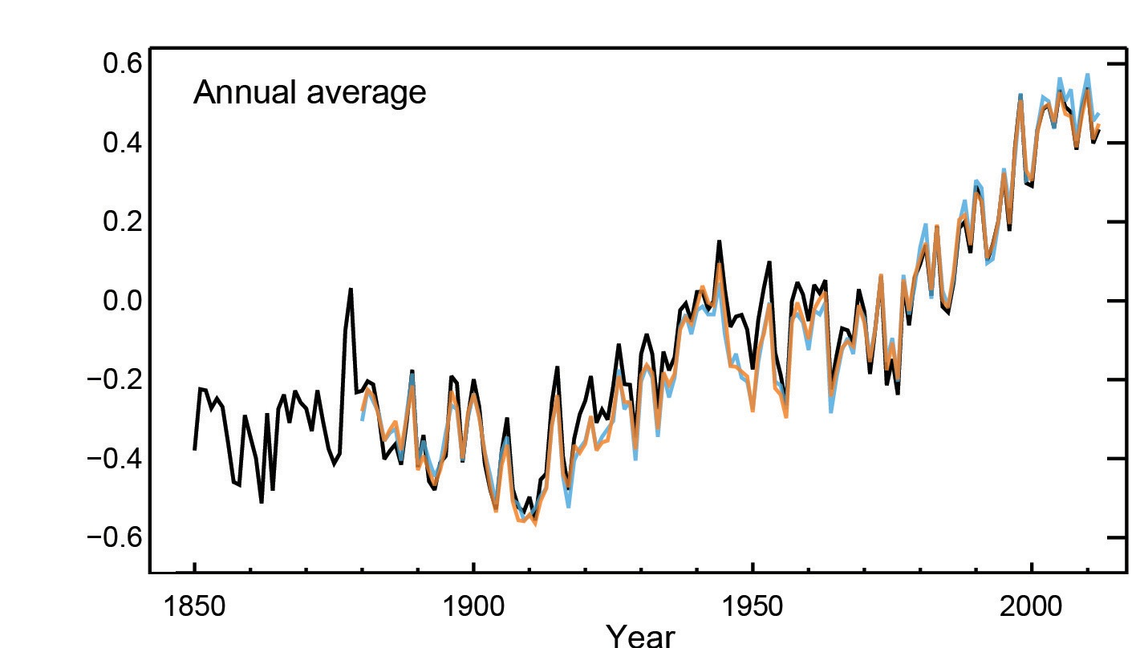
Humans are changing the climate
It is extremely likely that we are the dominant cause of warming since the mid-20th century
Year
Globally averaged combined land and ocean surface temperatures
AR5 WGI SPM

Slide 4
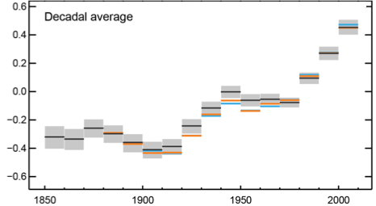
Temperatures continue to rise
Each of the past 3 decades has been successively warmer than the preceding decades since 1850
Year
Globally averaged combined land and ocean surface temperatures
AR5 WGI SPM

Slide 5
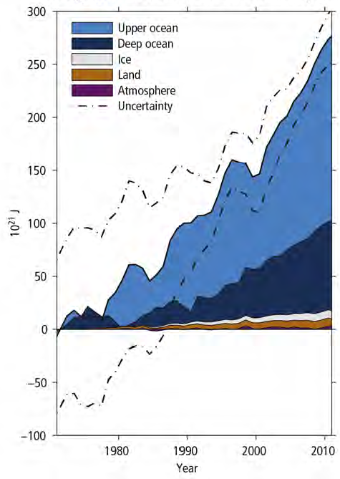
Oceans absorb most of the heat
  More than 90% of the energy accumulating in the climate system between 1971 and 2010 has accumulated in the ocean
  Land temperatures remain at historic highs while ocean temperatures continue to climb
AR5 SYR

Slide 6
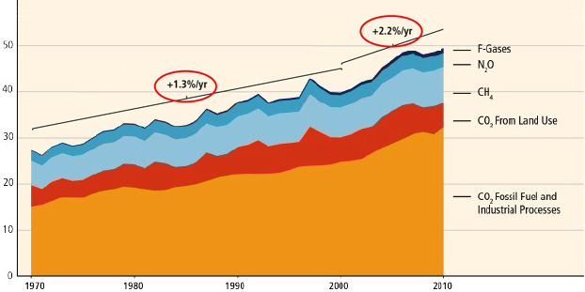
GHG emissions growth between 2000 and 2010 has been larger than in the previous three decades
GHG Emissions [GtCO2 eq/yr]
AR5 WGIII SPM

Slide 7






Sources of emissions
Energy production remains the primary driver of GHG emissions
24%
14%
6.4%
21%
35%
Building
Sector
Agriculture,
forests and
other land uses
Industry
Transport
Energy Sector
2010 GHG emissions
AR5 WGIII SPM

Slide 8
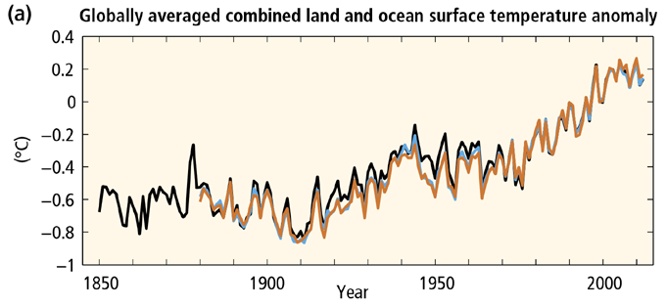
AR5 SYR SPM

Slide 9
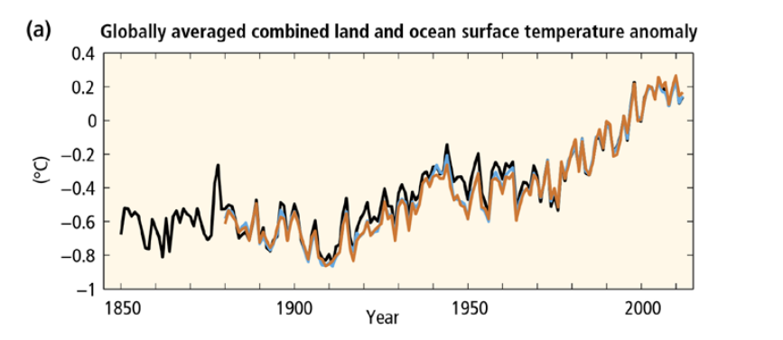
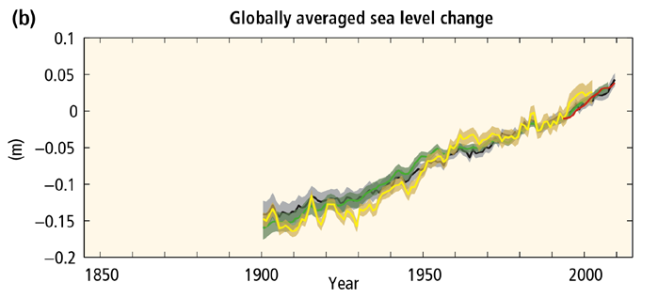
AR5 SYR SPM

Slide 10
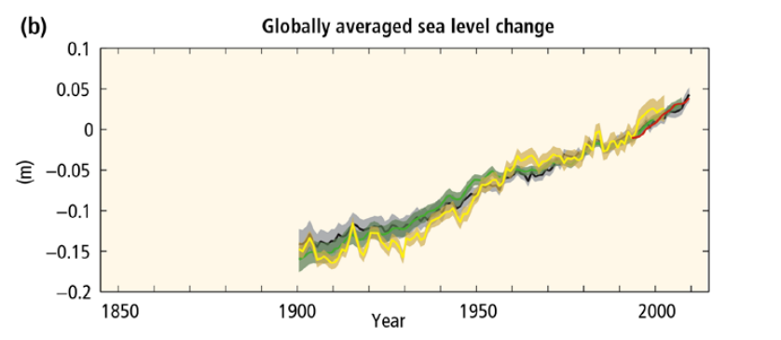
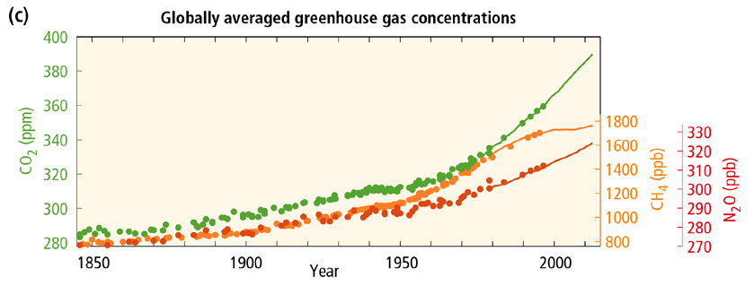
AR5 SYR SPM

Slide 11
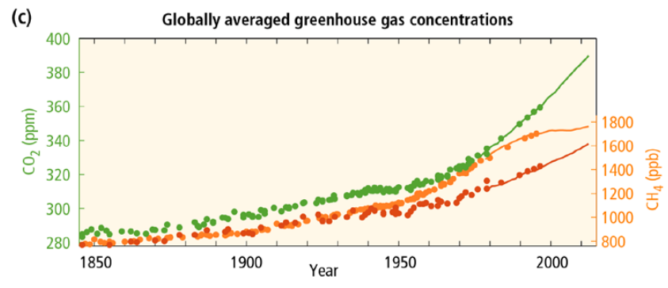
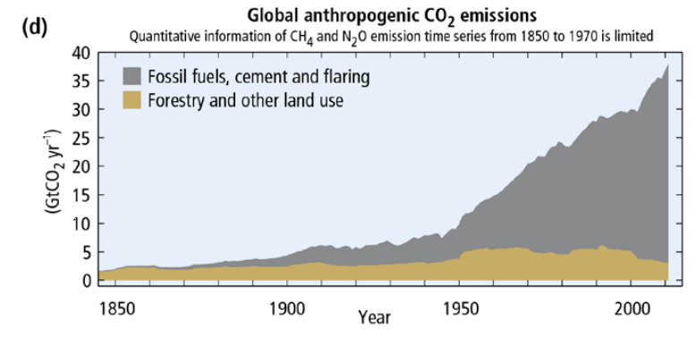
AR5 SYR SPM

Slide 12
AR5 SYR SPM

Slide 13
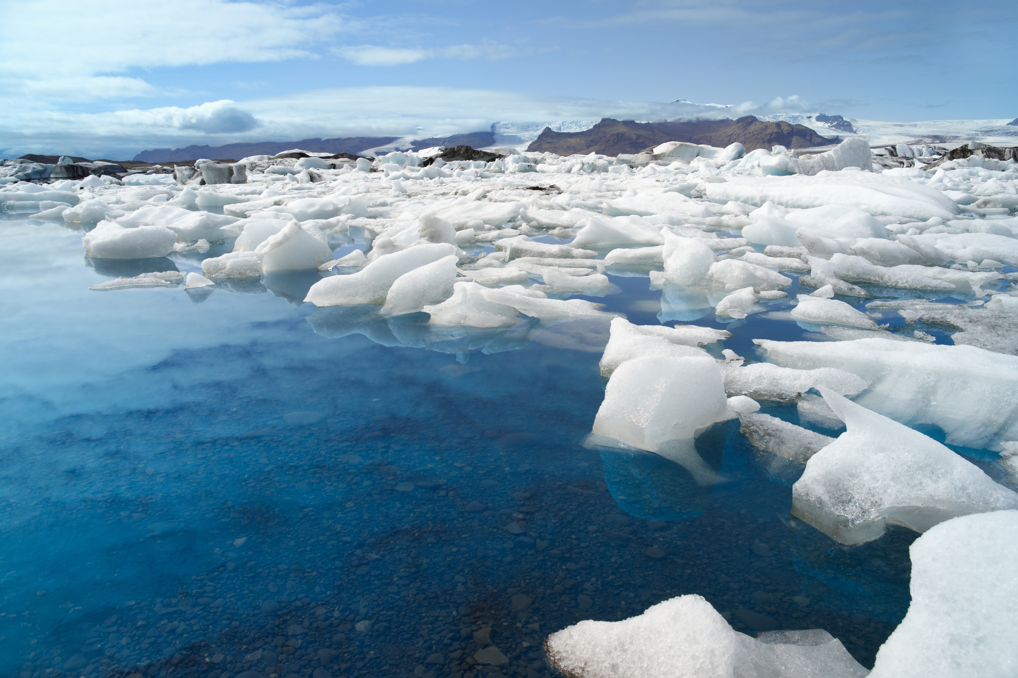
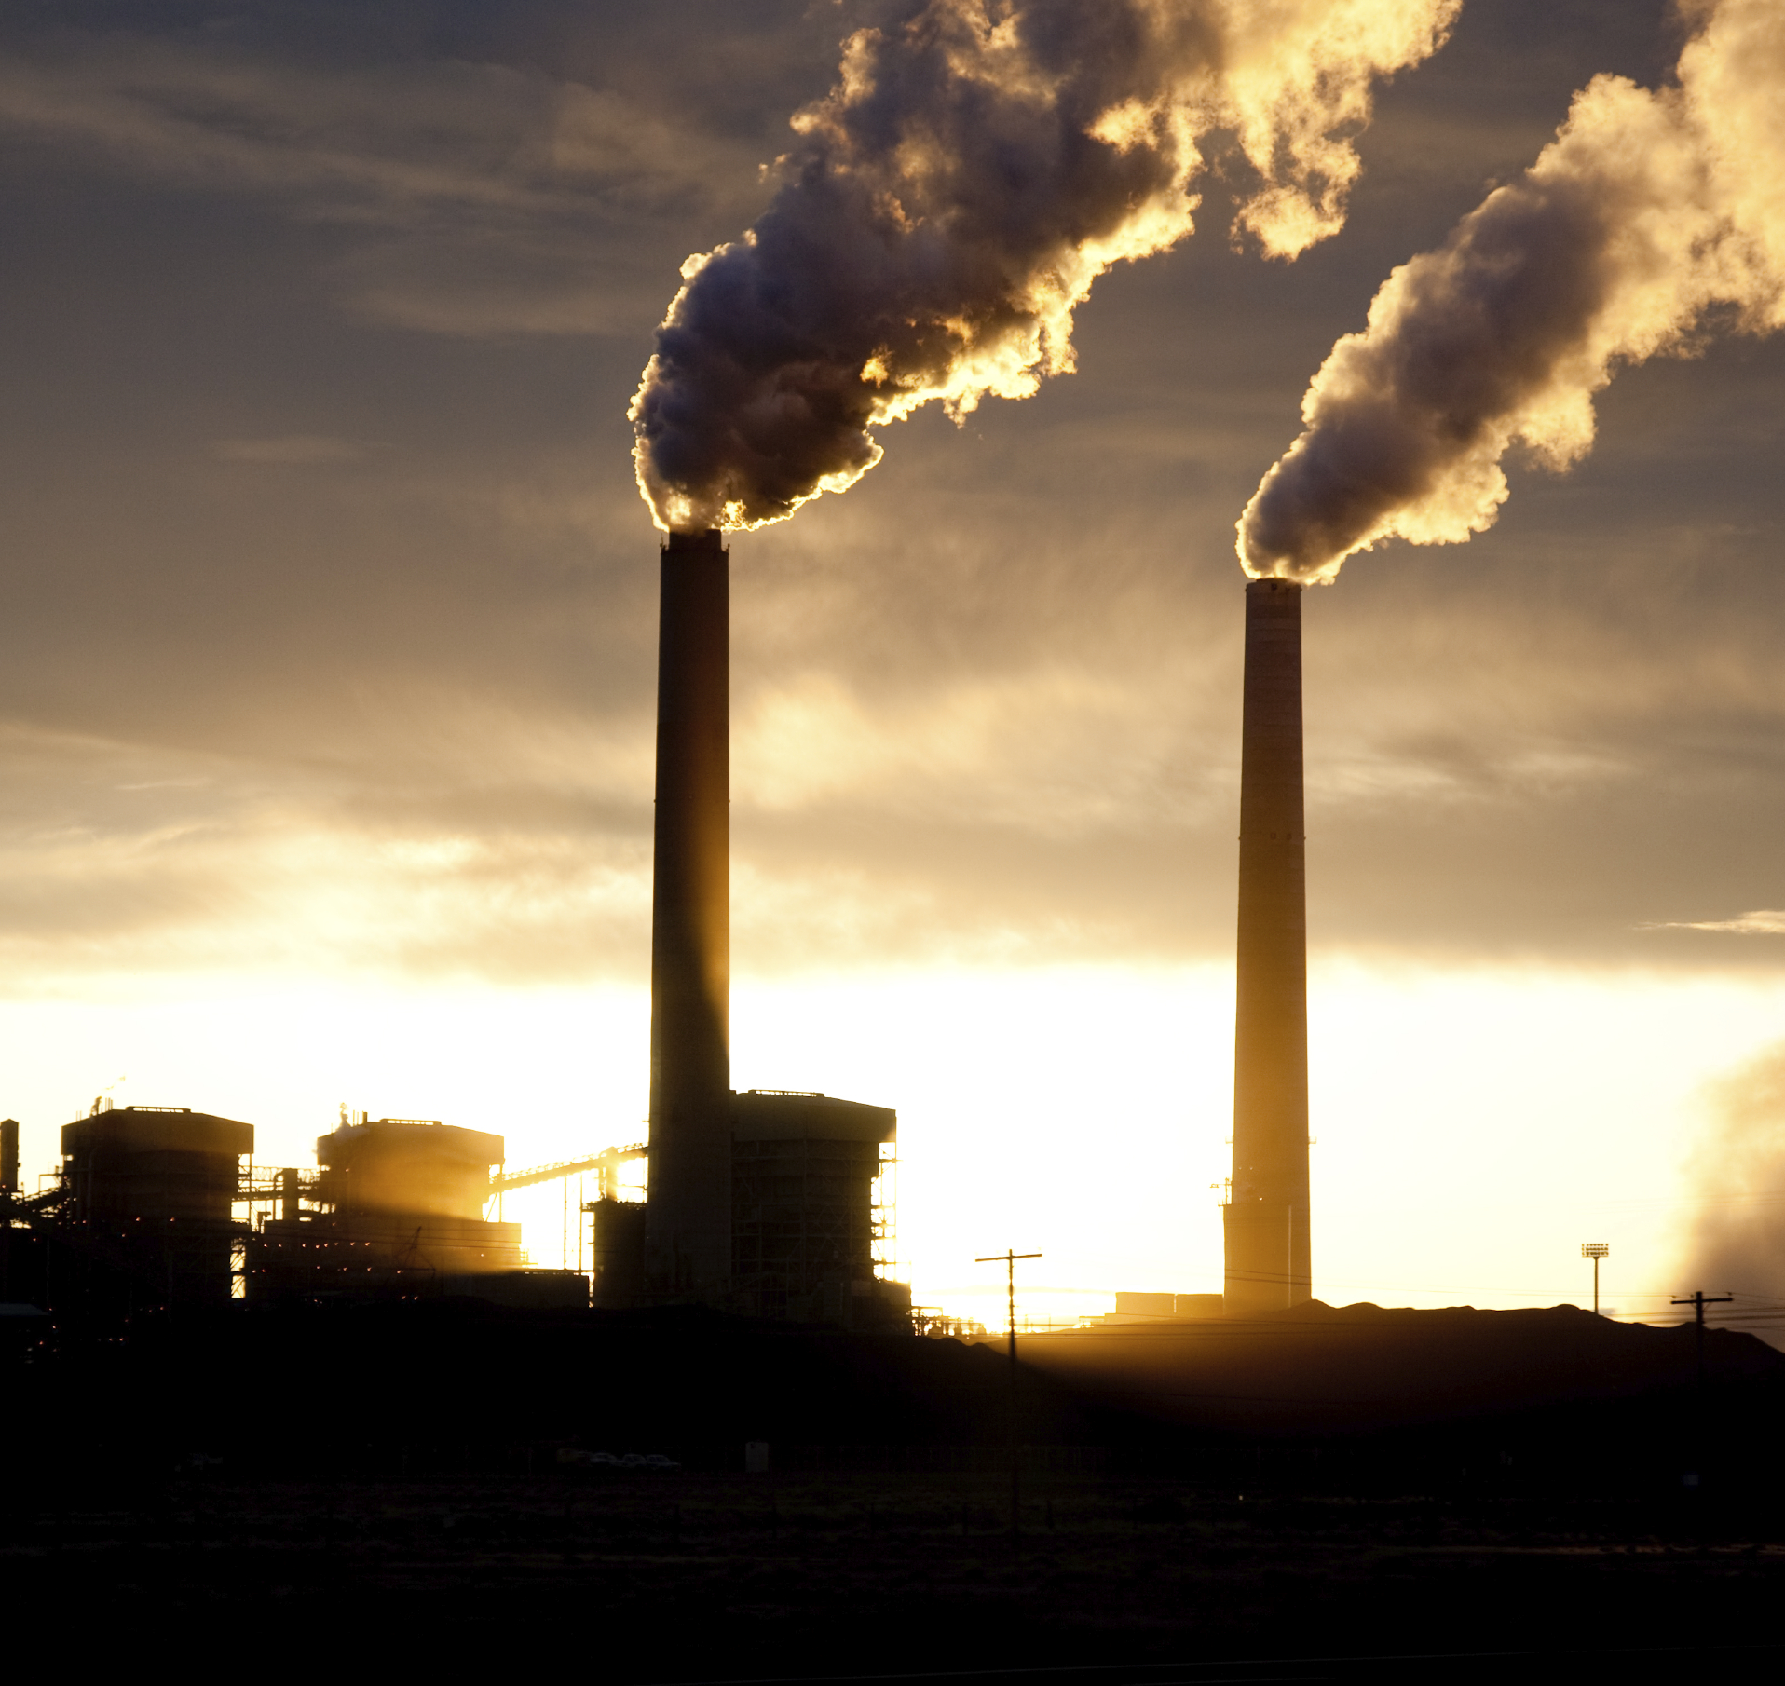
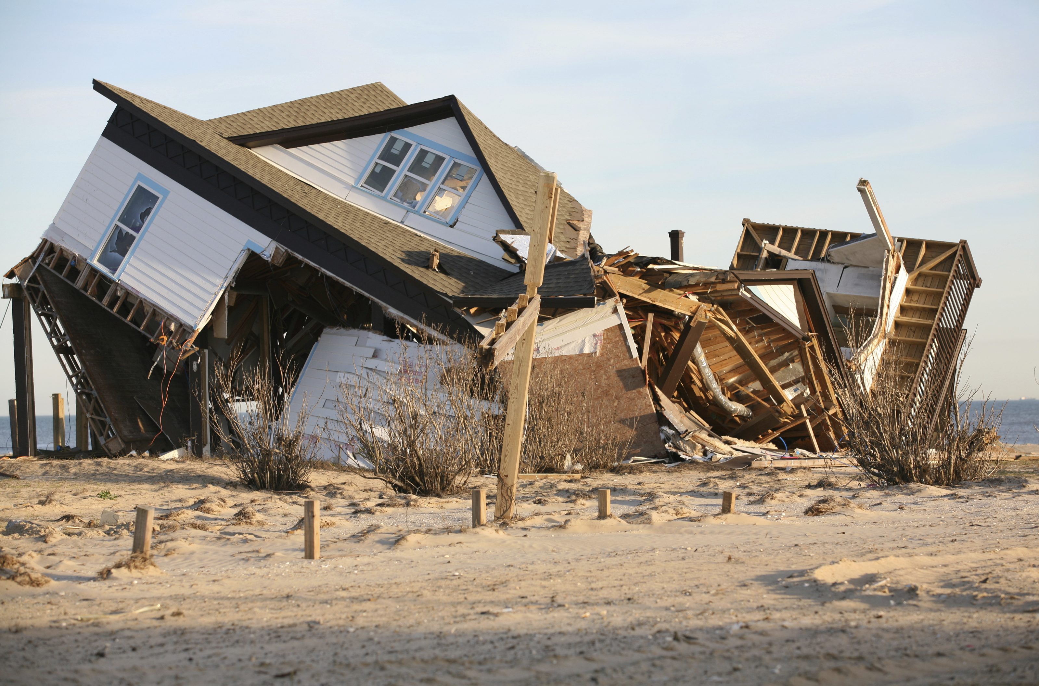
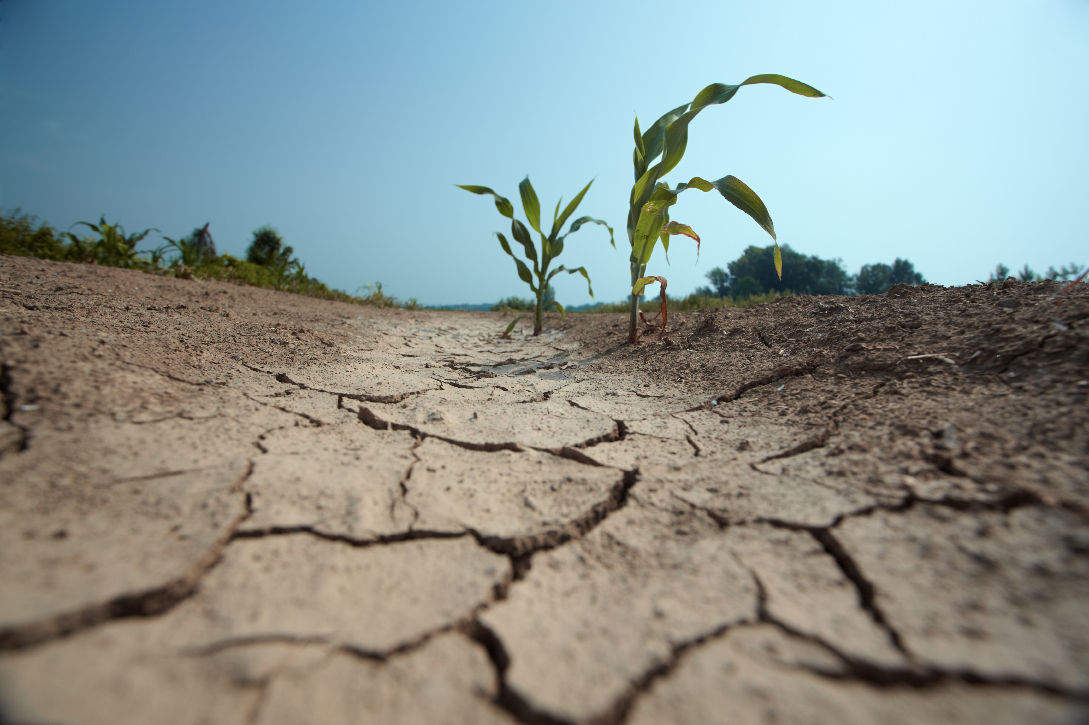
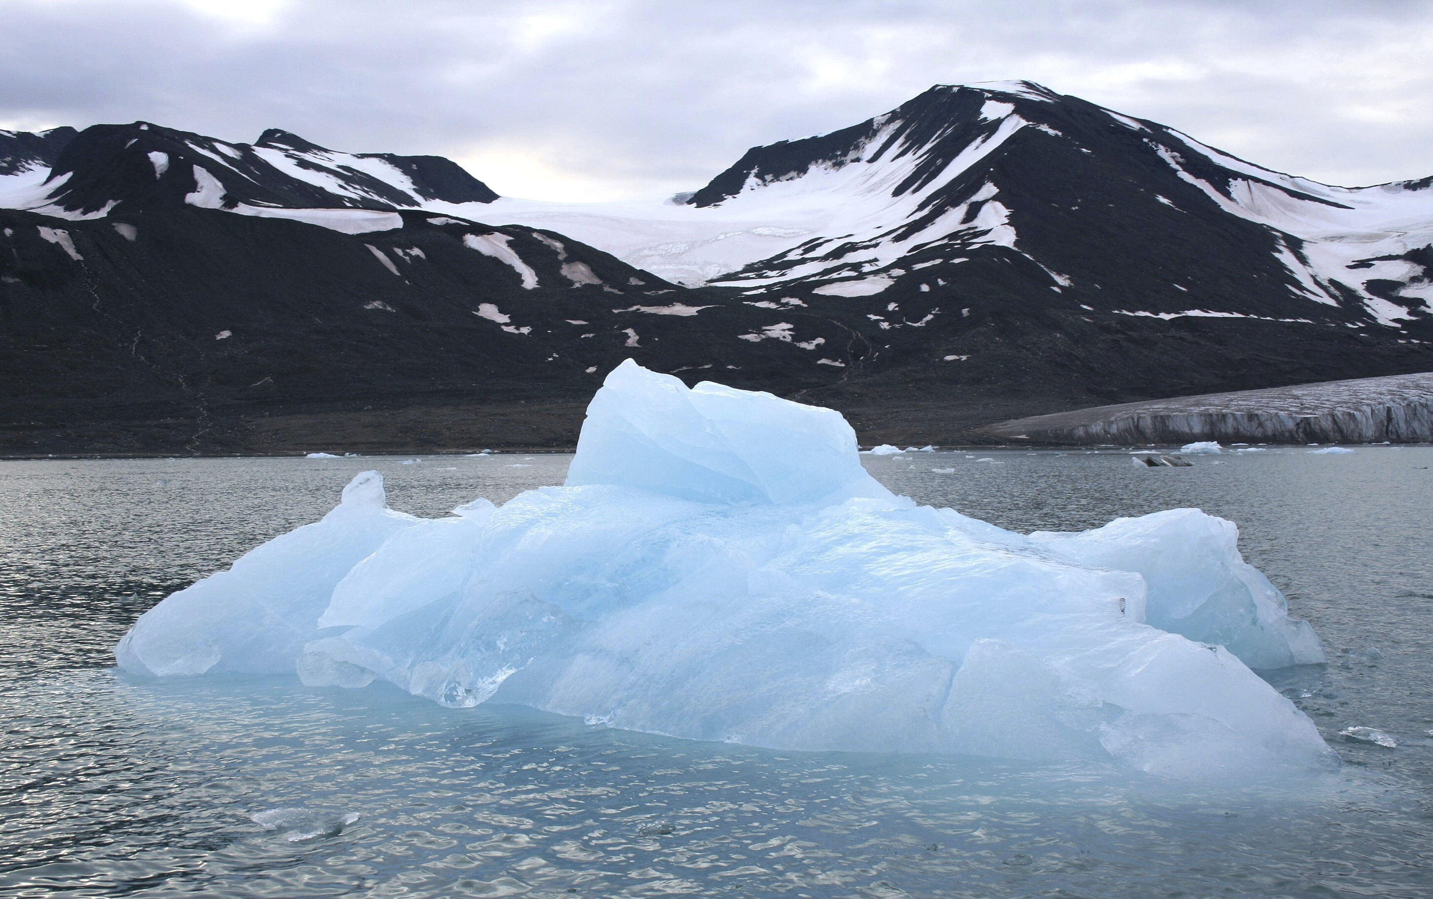
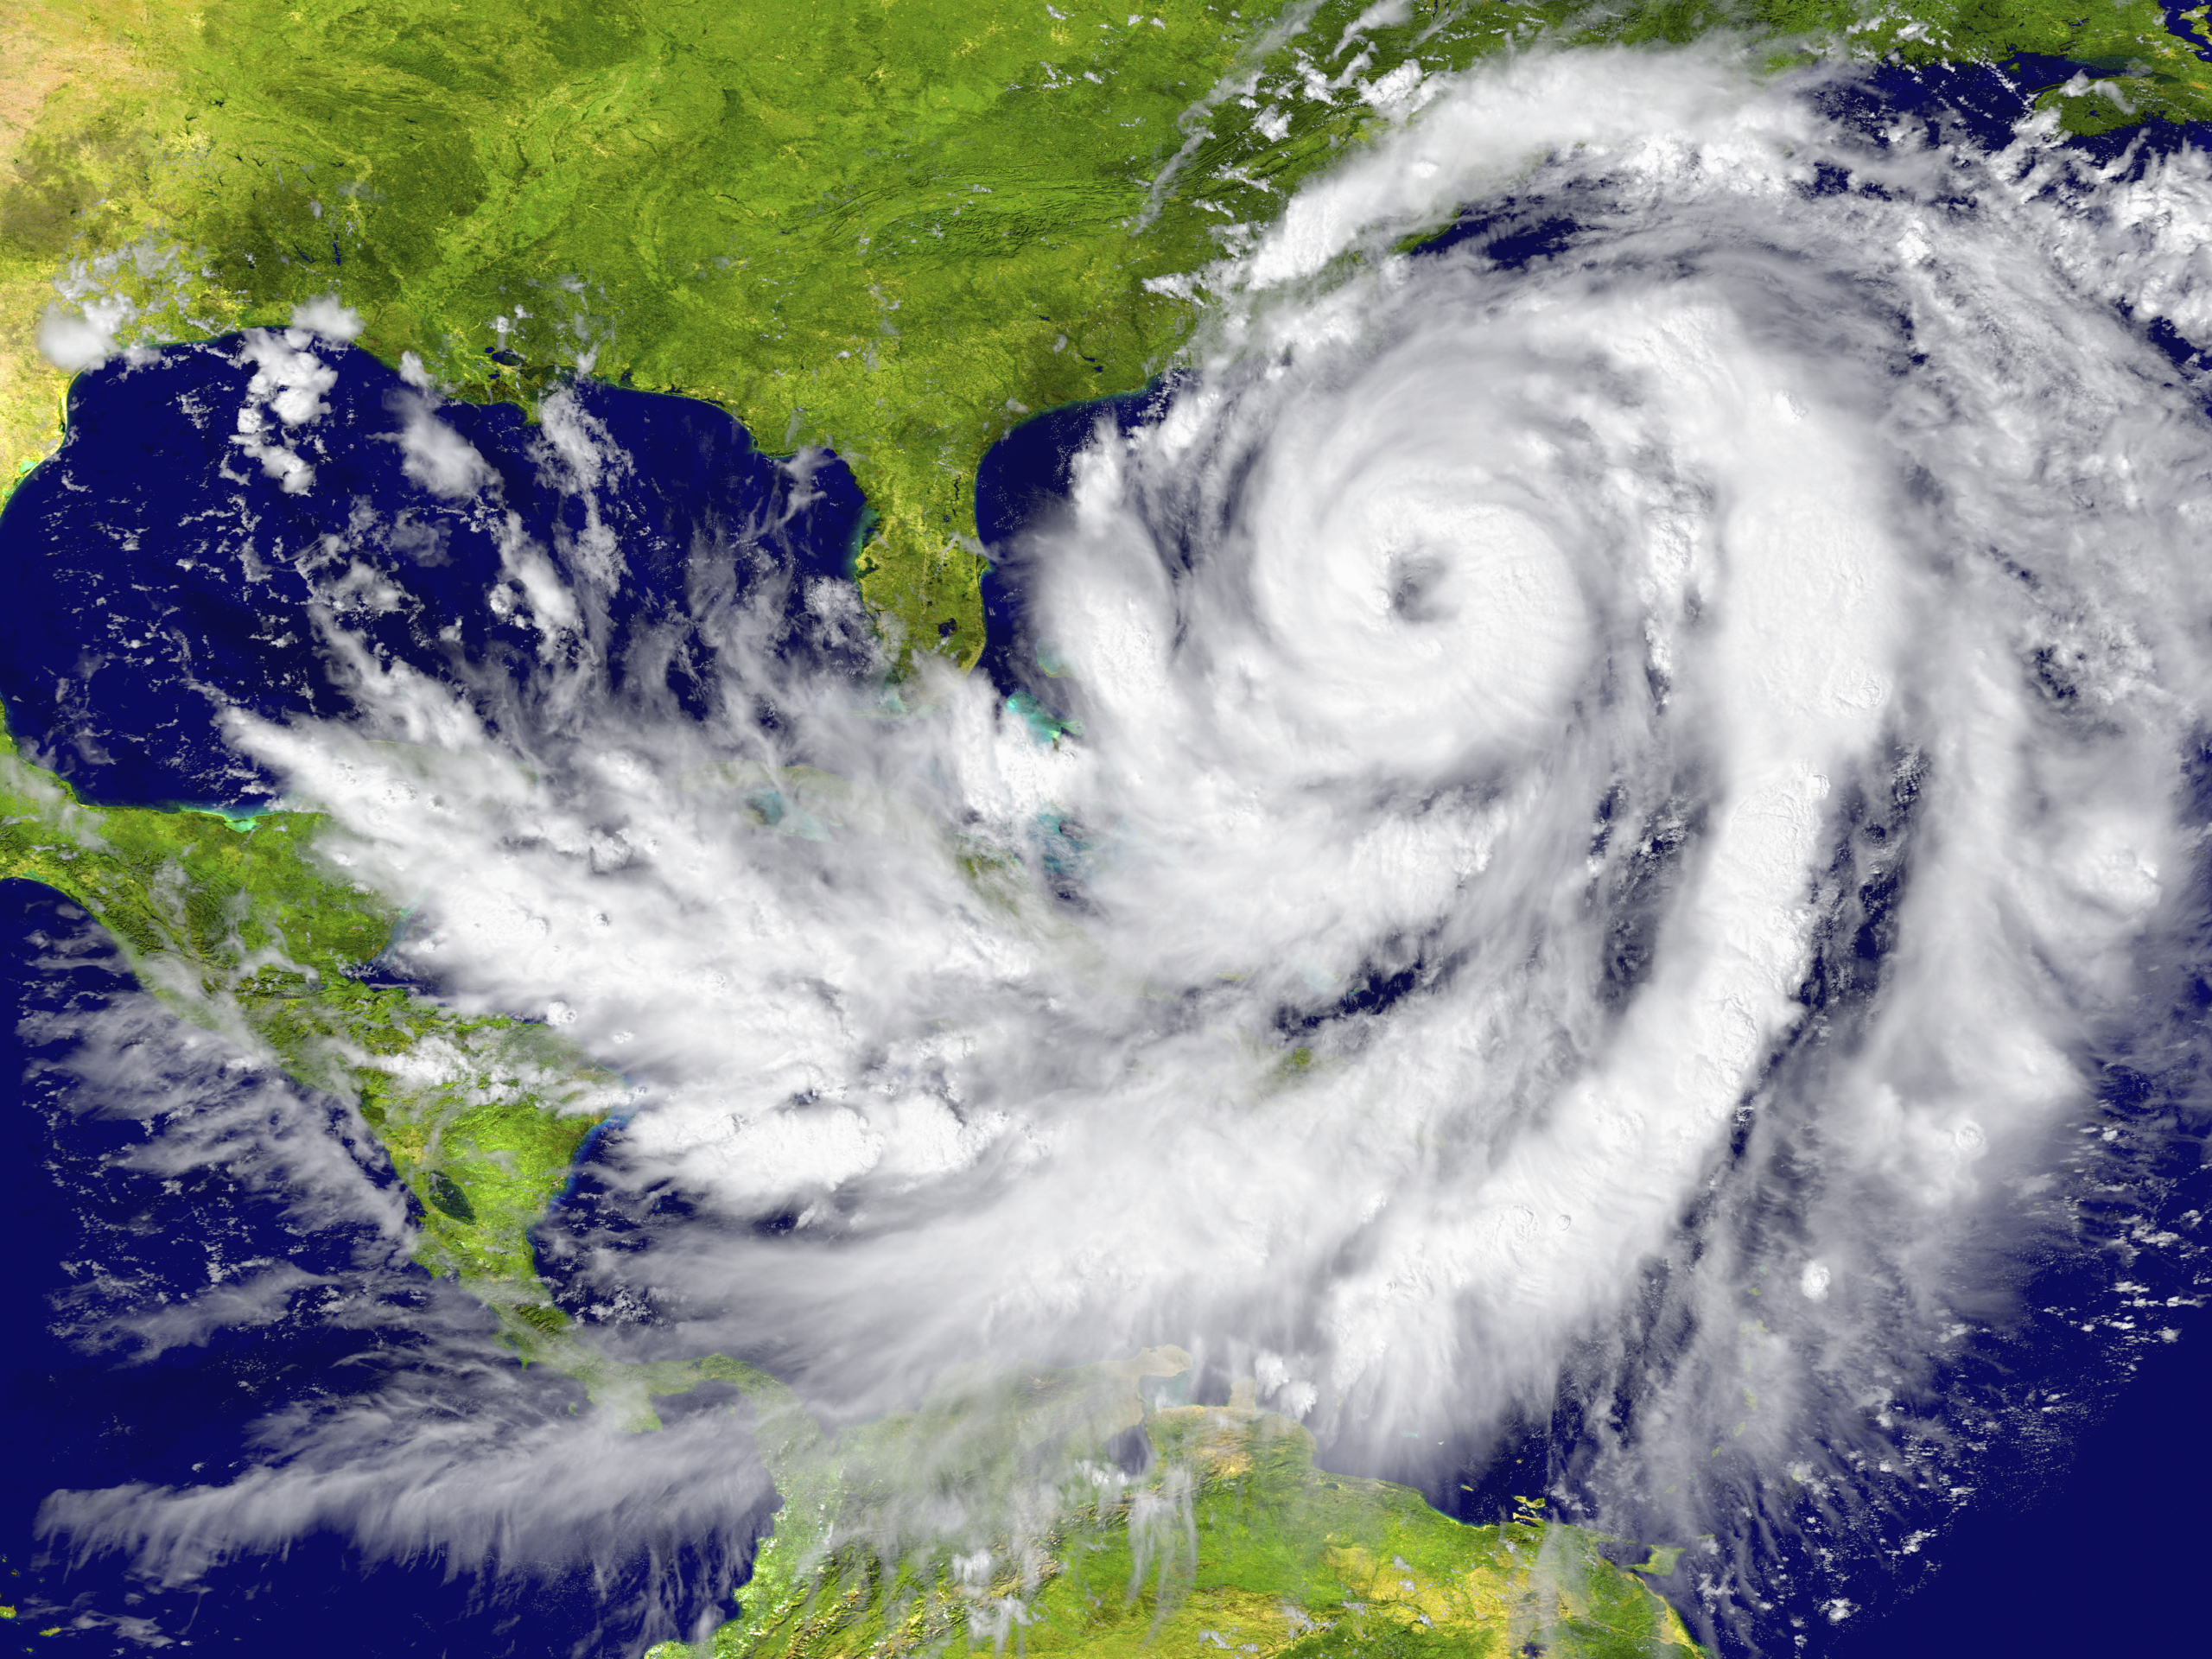
Some of the changes in extreme weather and climate events observed since about 1950 have been linked to human influence
AR5 WGI SPM

Slide 14
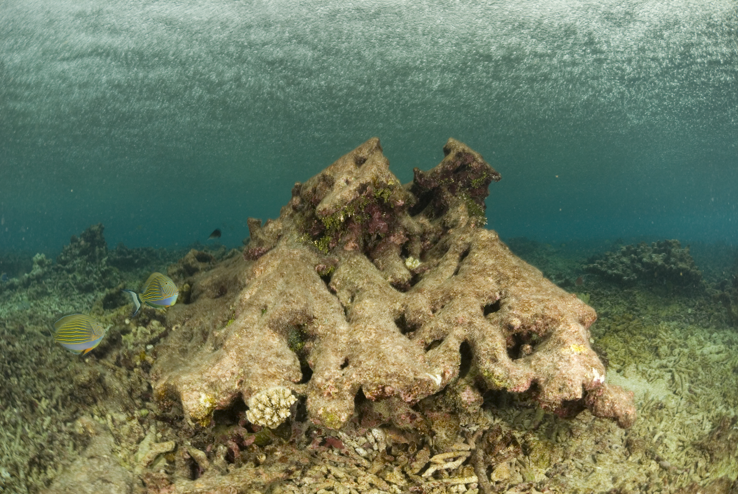
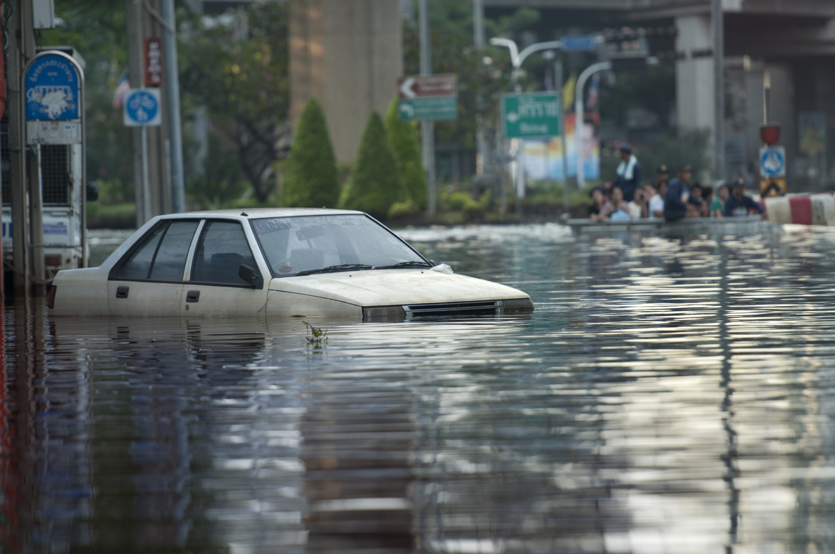
Impacts are already underway
  Tropics to the poles
  On all continents and in the ocean
  Affecting rich and poor countries
AR5 WGII SPM

Slide 15
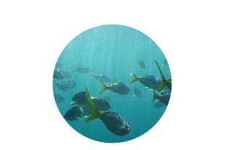
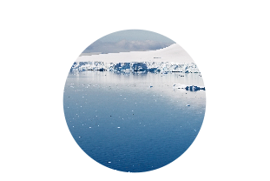
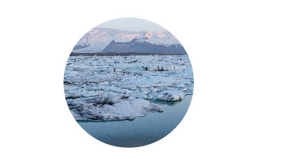

Projected climate changes
Continued emissions of greenhouse gases will cause further warming and changes in the climate system
Oceans will continue to warm during the 21st century
Global mean sea level will continue to rise during the 21st century
It is very likely that the Arctic sea ice cover will continue to shrink and thin as global mean surface temperature rises
Global glacier volume will further decrease
AR5 WGI SPM

Slide 16





Potential Impacts of Climate Change
Food and water shortages
Increased displacement of people
Increased poverty
Coastal flooding
AR5 WGII SPM

Slide 17


The window for action is rapidly closing
65% of our carbon budget compatible with a 2°C goal already used
Amount
Remaining:
Total Carbon
Budget:
²⁷⁵
^{GtC}
Amount Used
1870-2011:
⁷⁹⁰
^{GtC}
⁵¹⁵
^{GtC}
AR5 WGI SPM

Slide 18
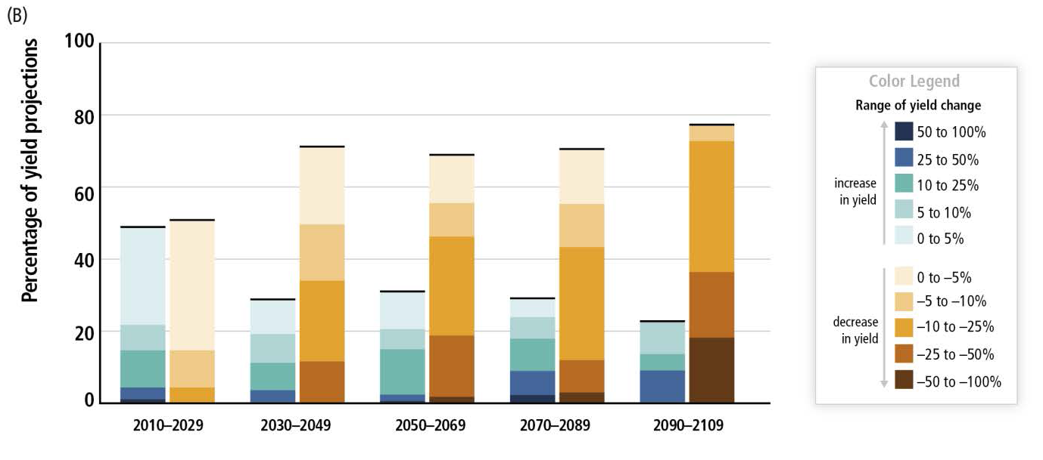
Climate Change Poses Risk for Food Production
Percentage of yield projections
AR5 SYR SPM

Slide 19
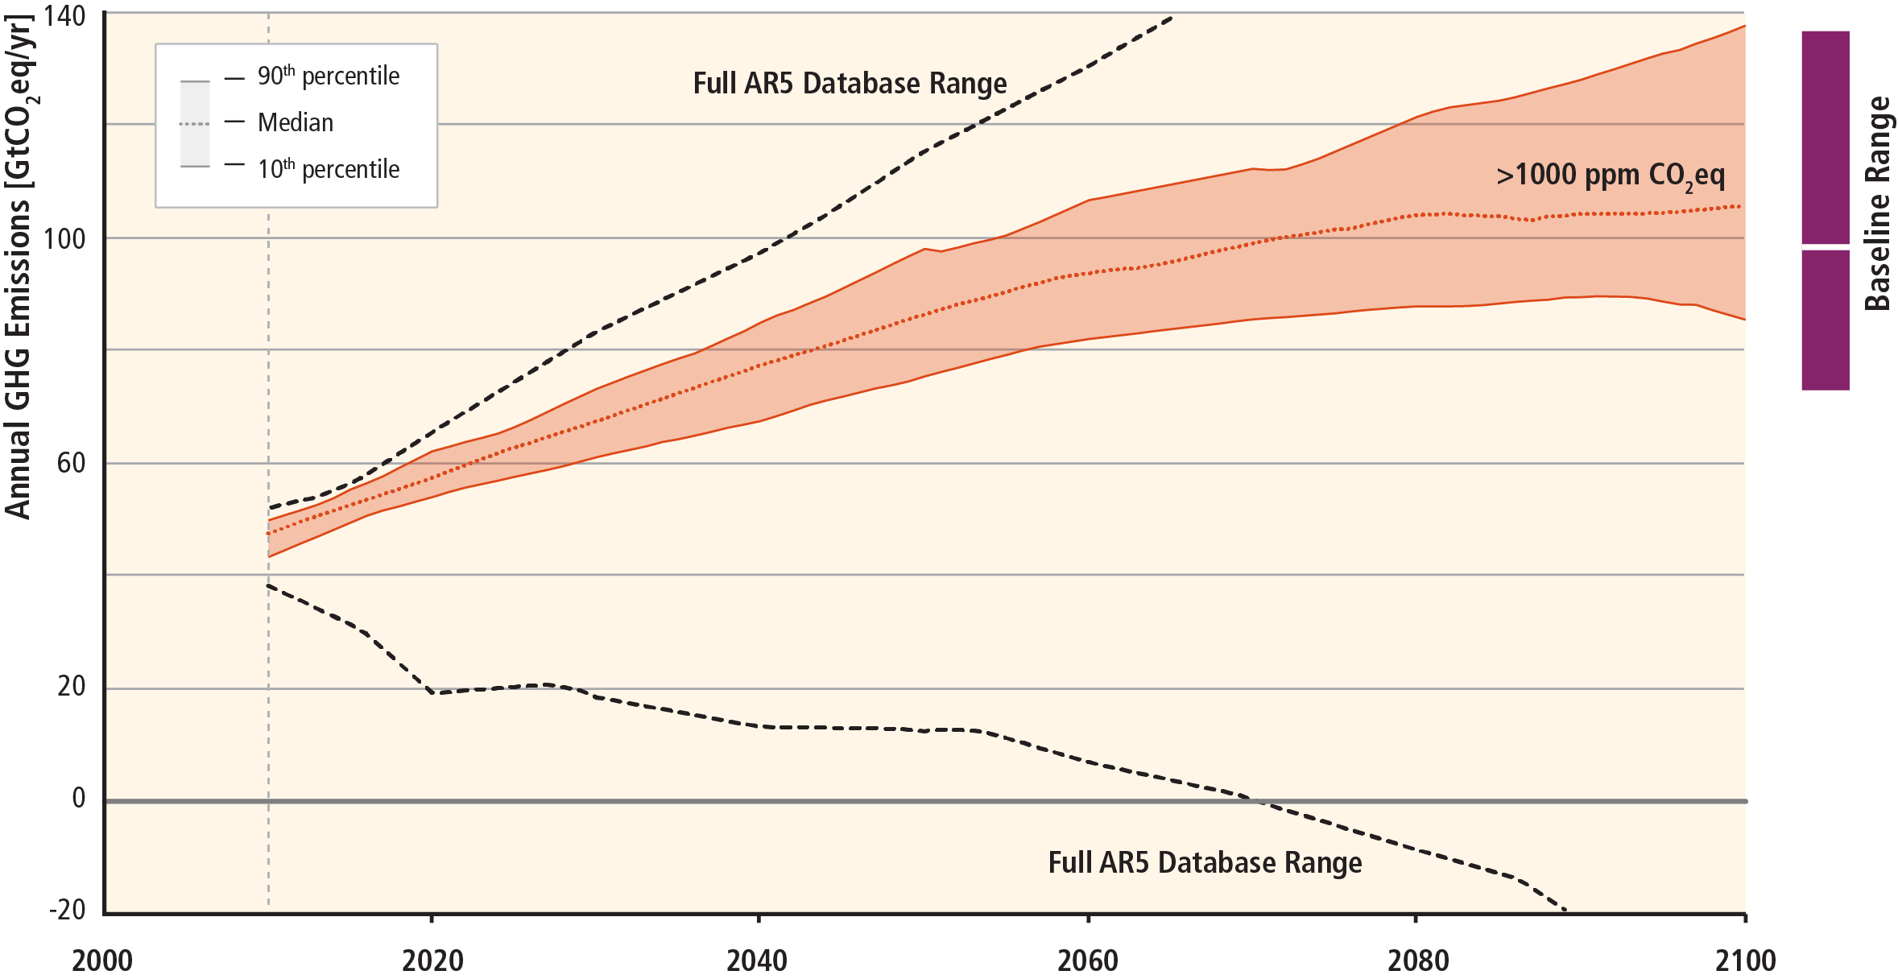
Stabilization of atmospheric concentrations requires moving away from the baseline – regardless of the mitigation goal.
AR5 WGIII SPM
Based on Figure 6.7

Slide 20
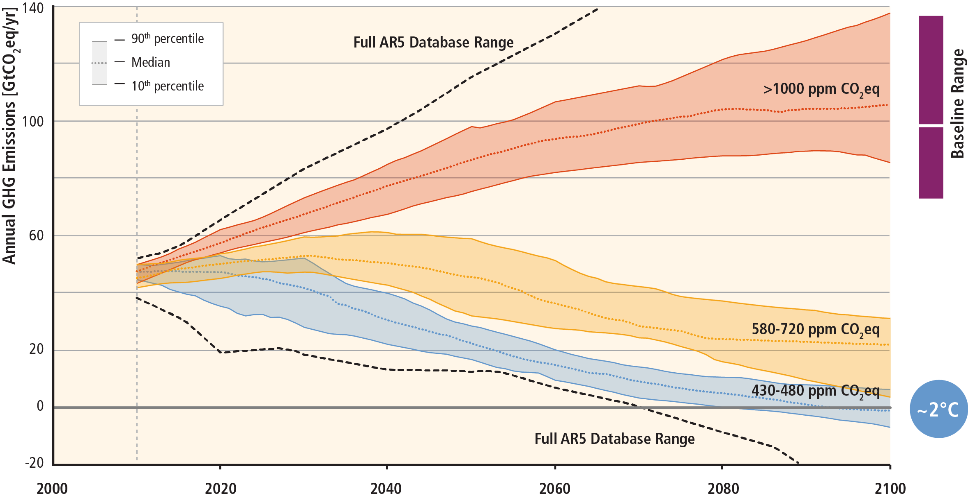
Stabilization of atmospheric concentrations requires moving away from the baseline – regardless of the mitigation goal.
~3°C
Based on Figure 6.7
AR5 WGIII SPM

Slide 21
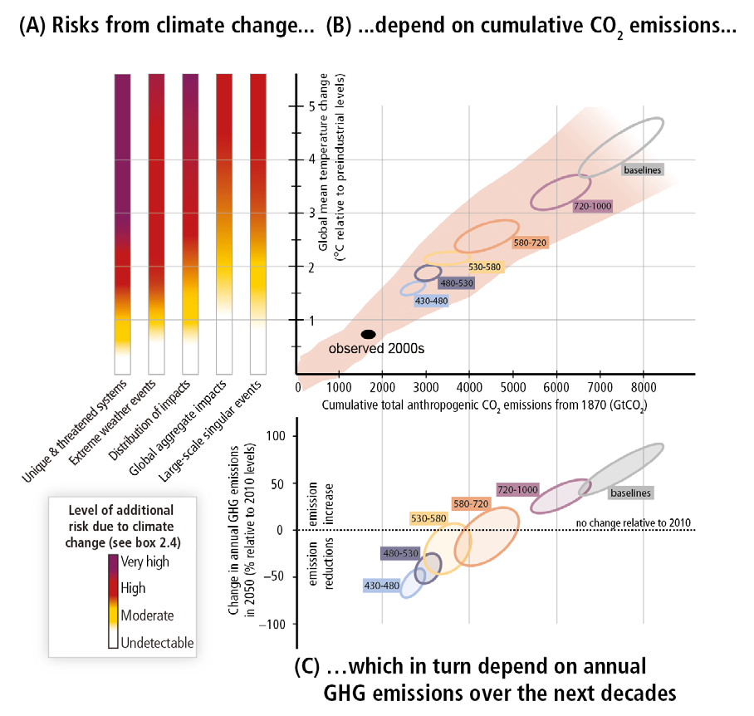
Figure SPM.10,
A reader’s guide
From climate change risks to GHG emissionse

Slide 22
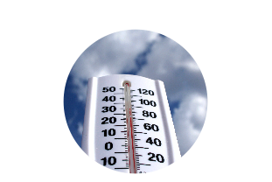
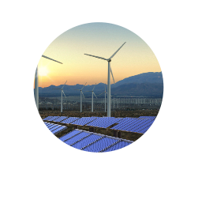
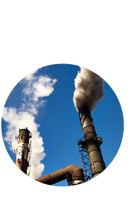

Limiting Temperature Increase to 2˚C
Measures exist to achieve the substantial emissions reductions required to limit likely warming to 2°C
A combination of adaptation and substantial, sustained reductions in greenhouse gas emissions can limit climate change risks
Implementing reductions in greenhouse gas emissions poses substantial technological, economic, social, and institutional challenges
But delaying mitigation will substantially increase the challenges associated with limiting warming to 2°C
AR5 WGI SPM, AR5 WGII SPM,AR5 WGIII SPM

Slide 23




Mitigation Measures
More efficient use of energy
Greater use of low-carbon and no-carbon energy
• Many of these technologies exist today
Improved carbon sinks
• Reduced deforestation and improved forest management and planting of new forests
• Bio-energy with carbon capture and storage
Lifestyle and behavioural changes
AR5 WGIII SPM

Slide 24
Ambitious Mitigation Is Affordable
  Economic growth reduced by ~ 0.06%
  (BAU growth 1.6 - 3%)
  This translates into delayed and not forgone growth
  Estimated cost does not account for the benefits of reduced climate change
  Unmitigated climate change would create increasing risks to economic growth
AR5 WGI SPM, AR5 WGII SPM

Slide 25
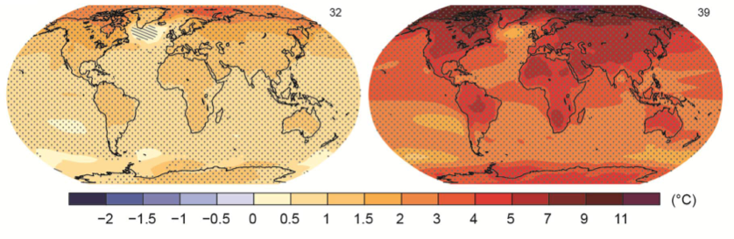
The Choices We Make Will Create Different Outcomes
With substantial mitigation
Without additional mitigation
Change in average surface temperature (1986–2005 to 2081–2100)
AR5 WGI SPM

Slide 26
IPCC Fifth Assessment Report
Synthesis Report

